Slide 1

Computer Networks
Transport Layer Protocols
S.V.Jansi Rani
Associate Professor / CSE

Slide 2
AGENDA
Transport Layer Protocols
Simple protocol
Stop and wait protocol
Go back N protocol
Selective Repeat protocol

Slide 3



Slide 4
INTRODUCTION
The transport layer is located between the application layer and the network layer.
It provides a process-to-process communication between two application layers, one at the local host and the other at the remote host.
Communication is provided using a logical connection.

Slide 5
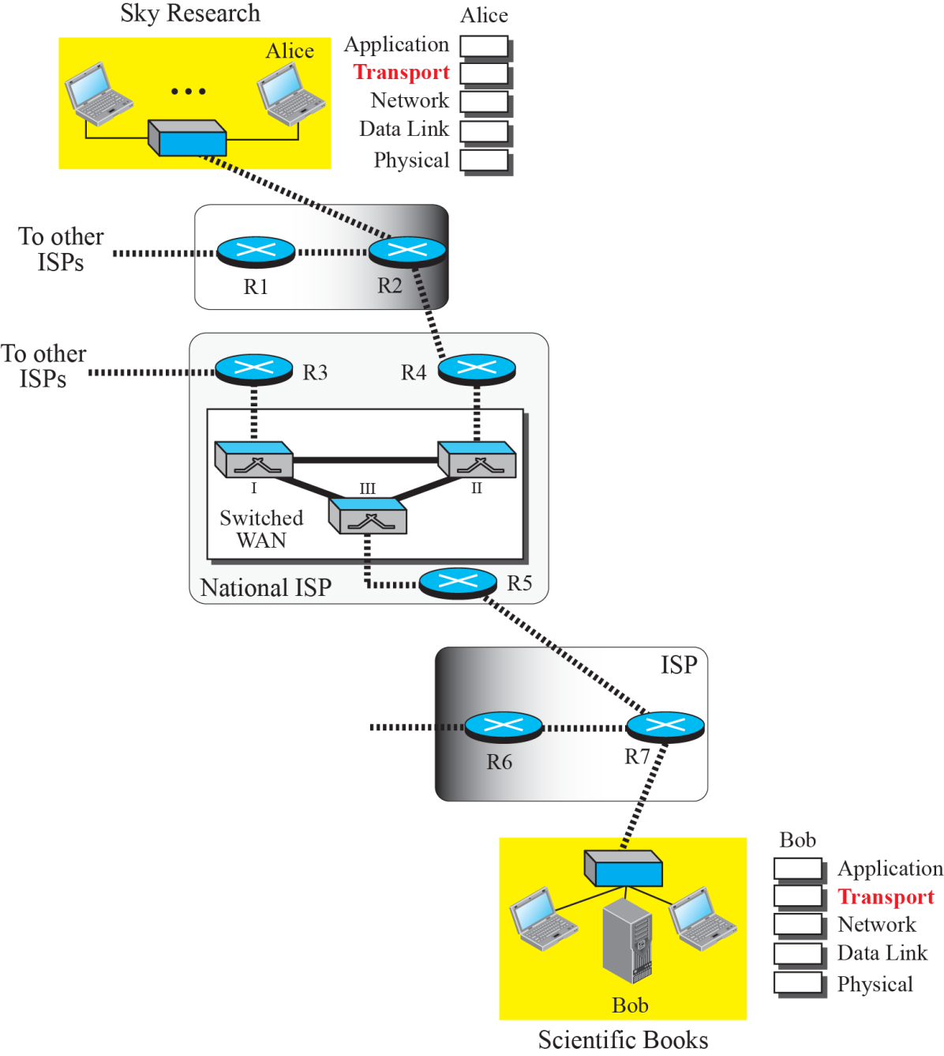

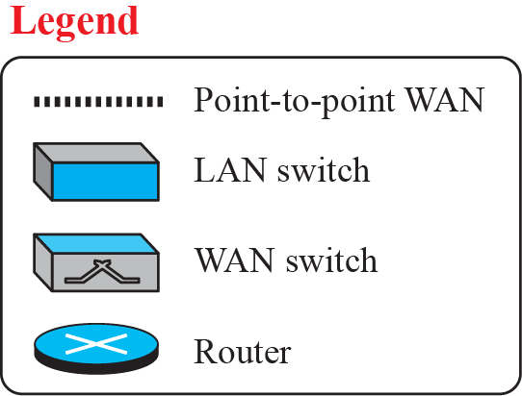
Logical connection at the transport layer

Slide 6
Transport-Layer Services
Transport layer is located between the network layer and the application layer.
The transport layer is responsible for providing services to the application layer; it receives services from the network layer.

Slide 7
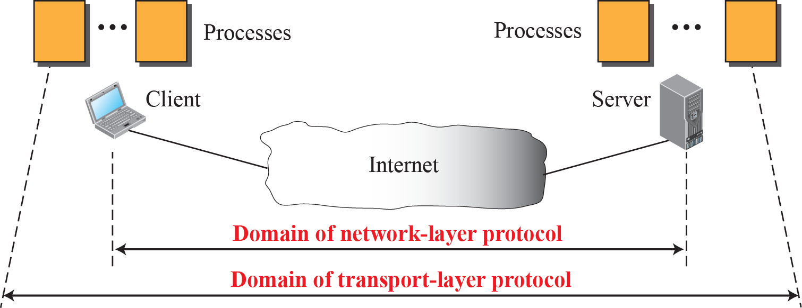
Network layer versus transport layer

Slide 8
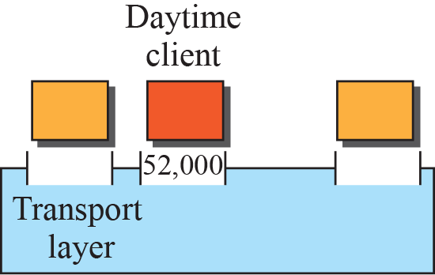
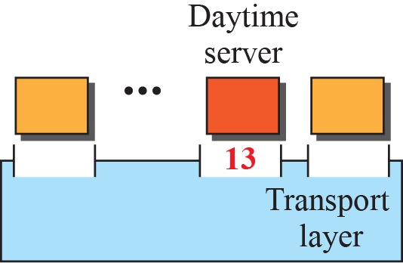
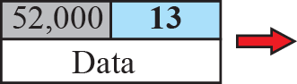
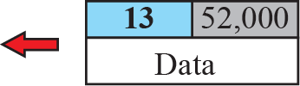
Port numbers

Slide 9
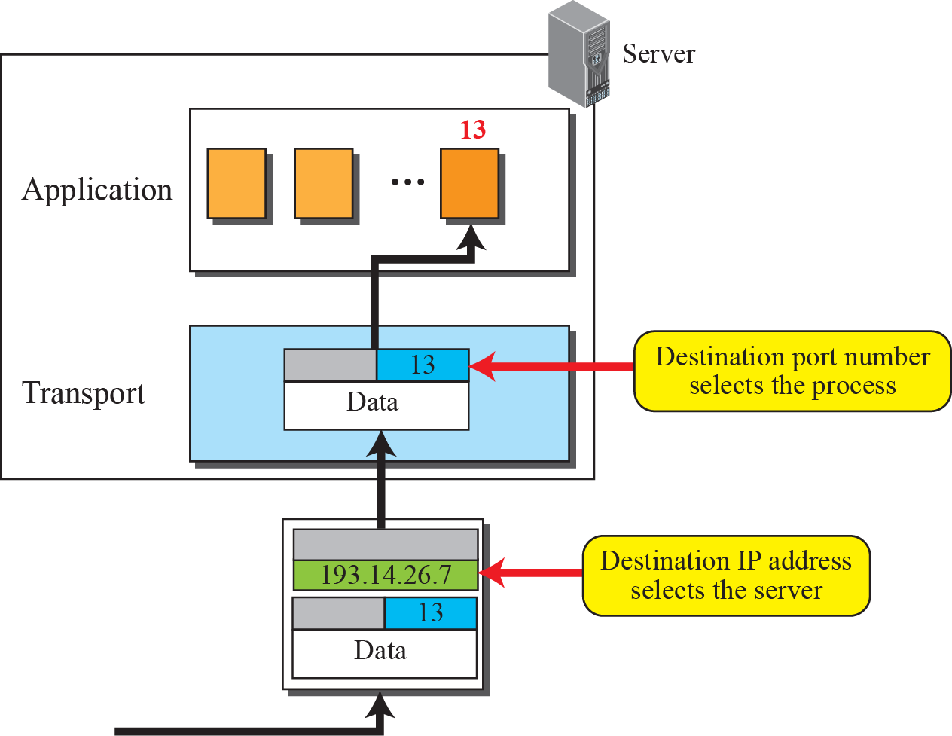
IP addresses versus port numbers

Slide 10
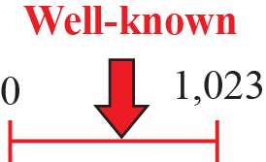
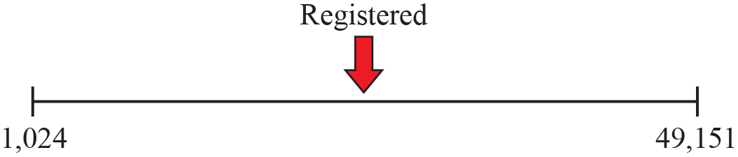
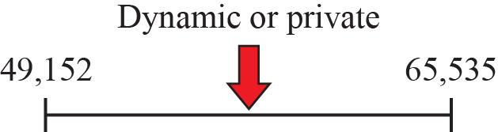
ICANN ranges

Slide 11
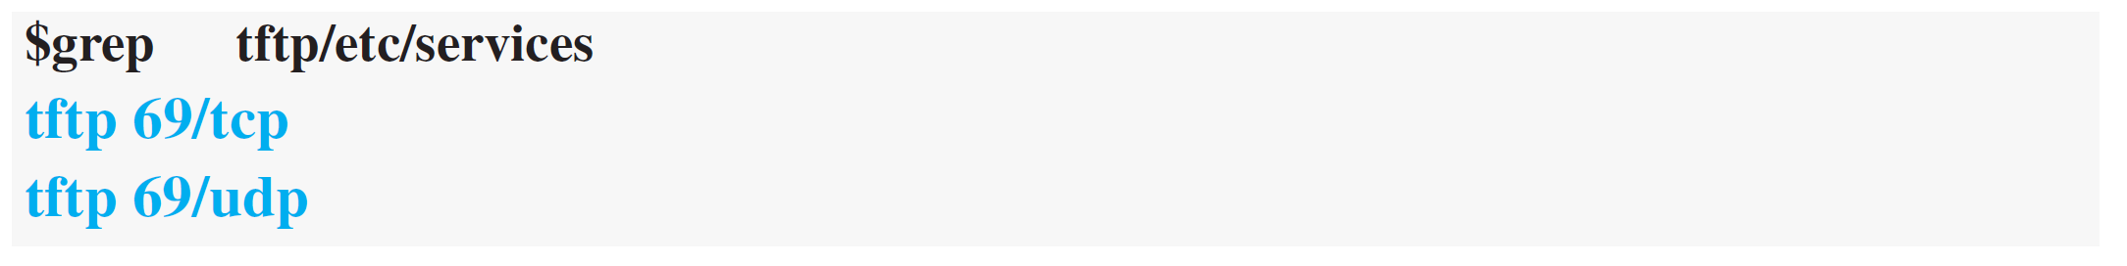
Example
In UNIX, the well-known ports are stored in a file called /etc/services. We can use the grep utility to extract the line corresponding to the desired application.
SNMP (see Chapter 27) uses two port numbers (161 and 162), each for a different purpose.

Slide 12
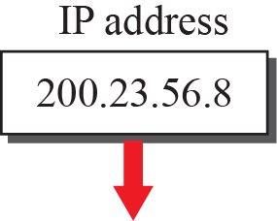
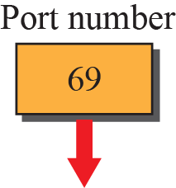
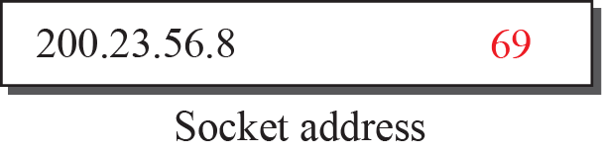
Socket address

Slide 13
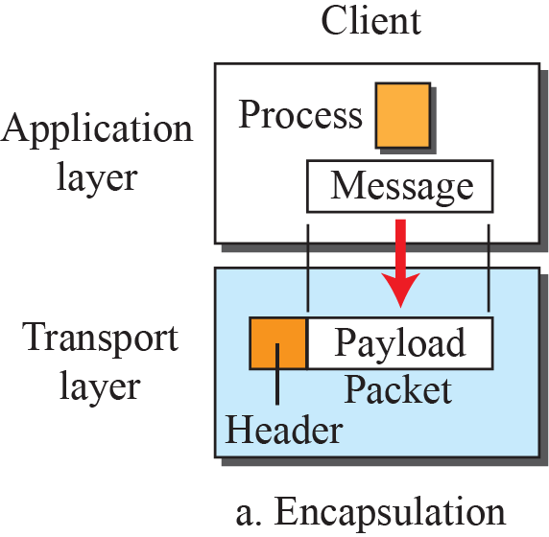
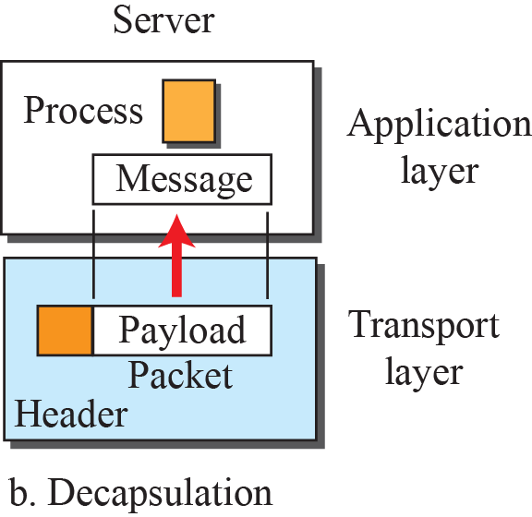

Encapsulation and decapsulation

Slide 14
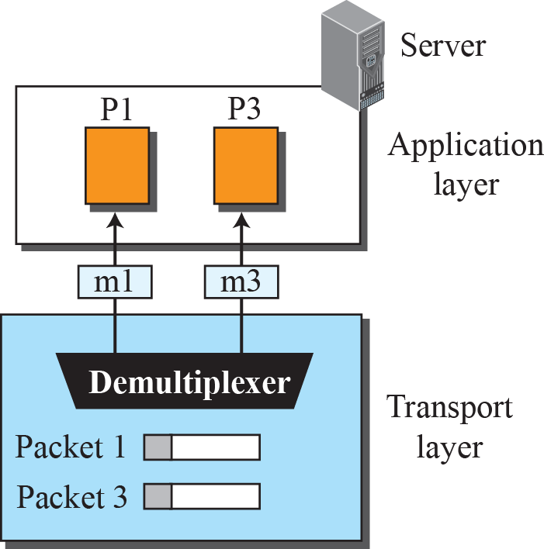
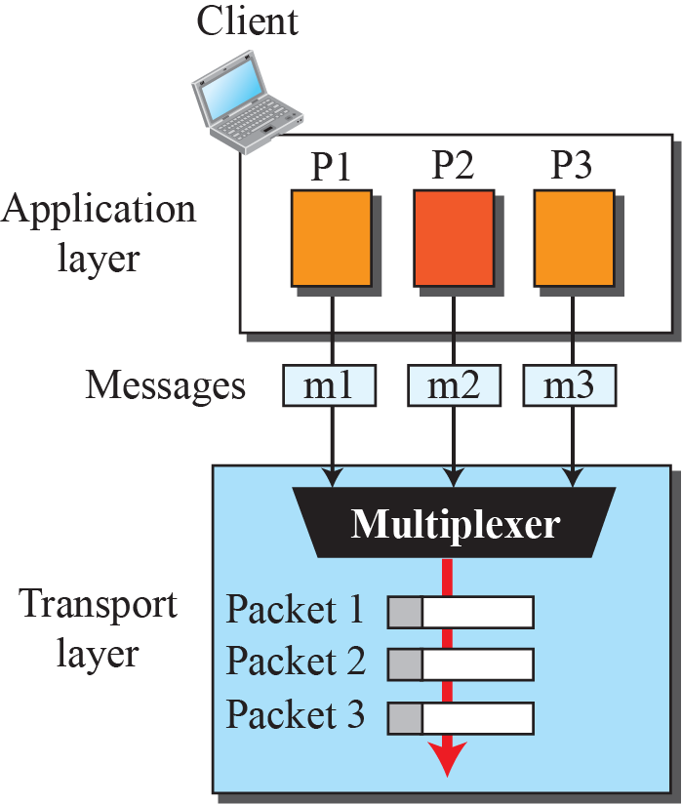
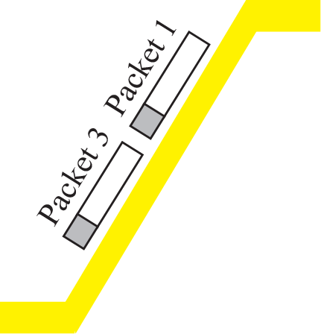
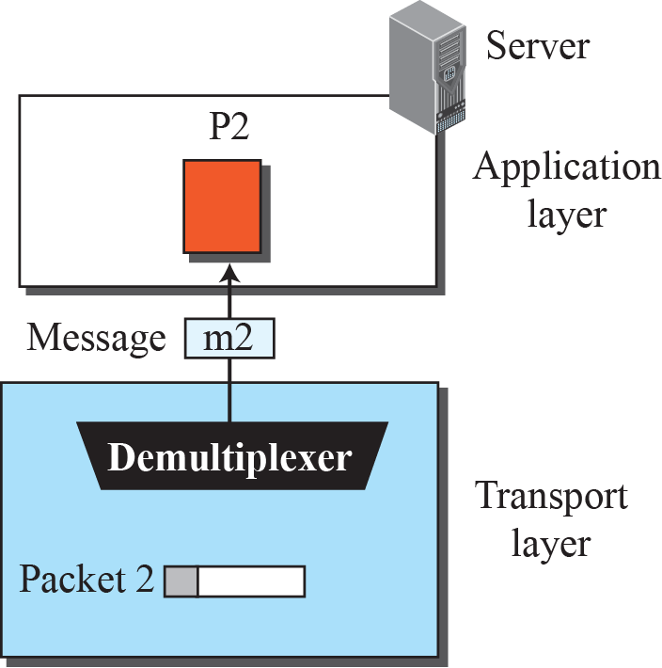
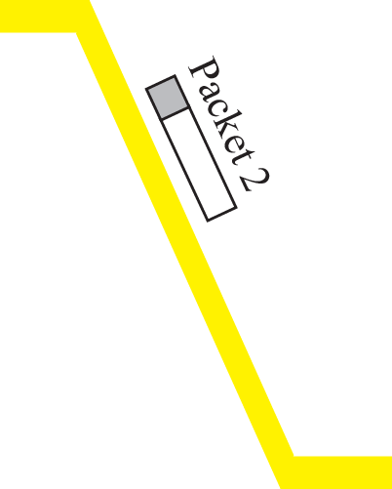
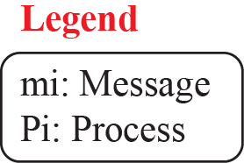
Multiplexing and demultiplexing

Slide 15

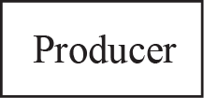
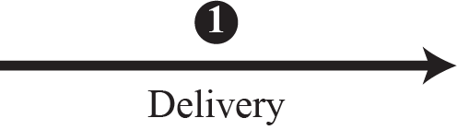
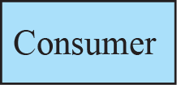
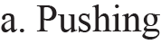
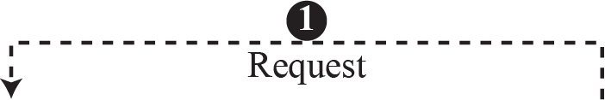

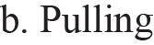
Pushing or pulling

Slide 16
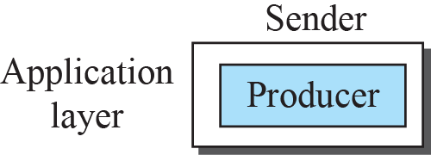
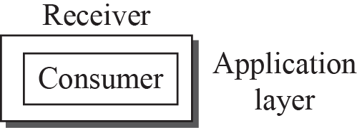
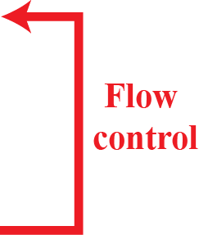
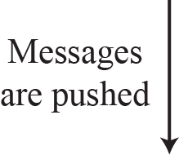
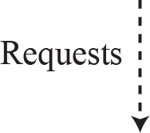
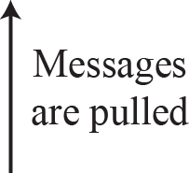
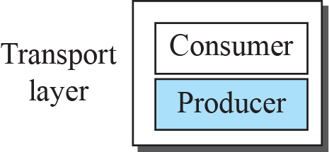
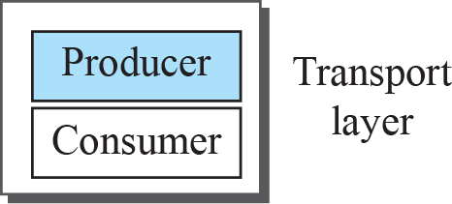

Flow control at the transport layer

Slide 17
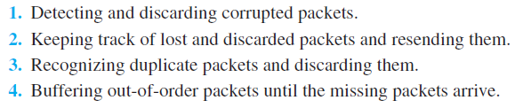
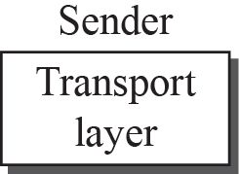
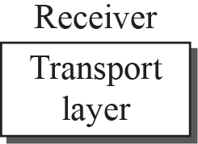
Error control at the transport layer

Slide 18
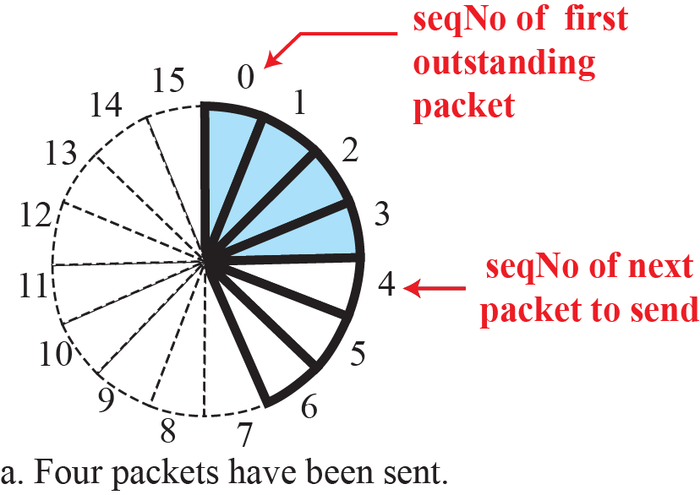
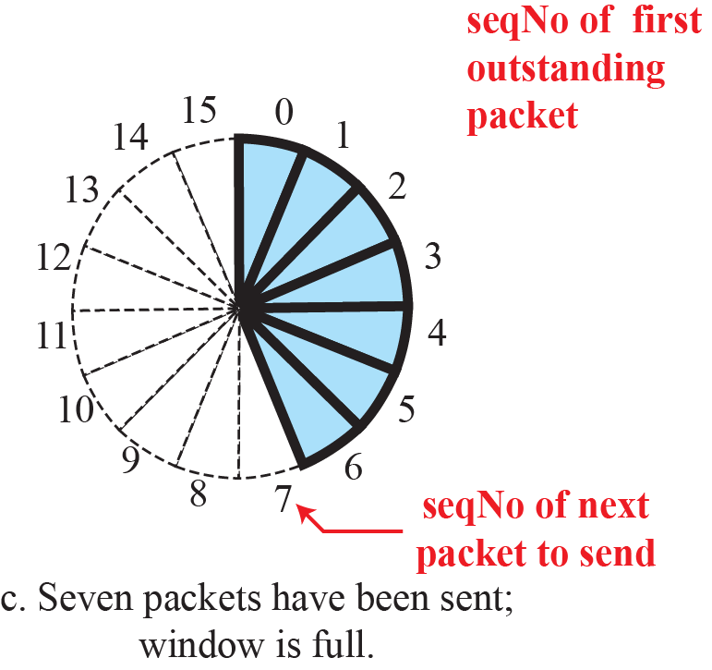
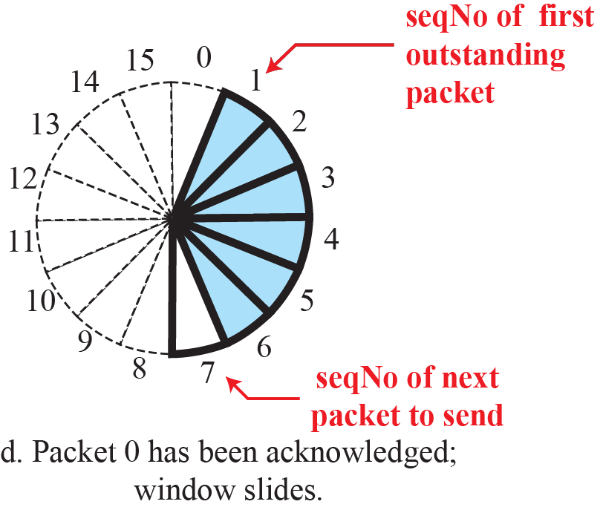
Sliding window in circular format
If the header of the packet
allows m bits for the sequence number, the sequence numbers range from 0 to 2^{m} − 1. Eg: m=4 , Seq.No: 0 to 15
Sequence numbers are modulo 2^{m}

Slide 19
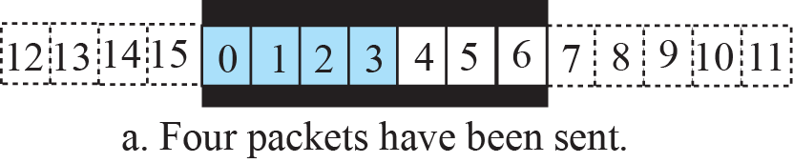
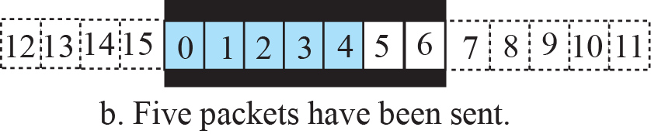
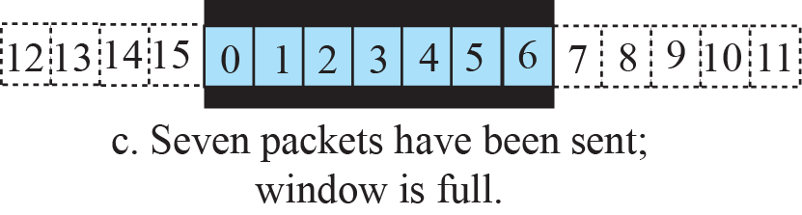
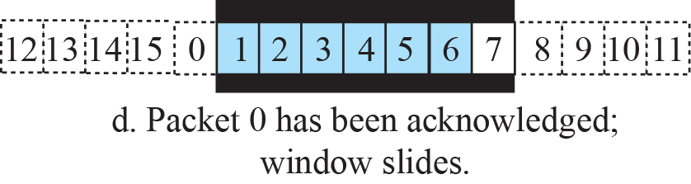
Sliding window in linear format

Slide 20
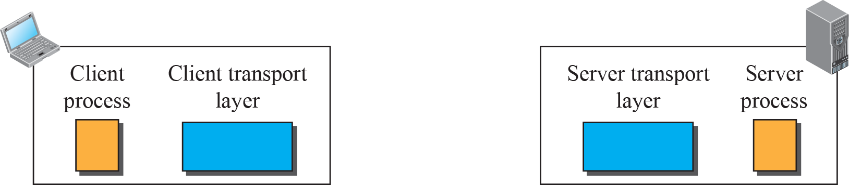
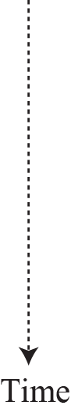
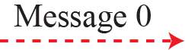






Connectionless service

Slide 21















Connection-oriented service

Slide 22



Connectionless and connection-oriented service represented as FSMs

Slide 23
TRANSPORT-LAYER PROTOCOLS
The TCP/IP protocol uses a transport-layer protocol that is either a modification or a combination of some of these protocols.

Slide 24
Simple Protocol
Our first protocol is a simple connectionless protocol with neither flow nor error control.
We assume that the receiver can immediately handle any packet it receives.
In other words, the receiver can never be overwhelmed with incoming packets.

Slide 25




Simple protocol

Slide 26


FSMs for the simple protocol

Slide 27






Flow diagram

Slide 28
Stop-and-Wait Protocol
Our second protocol is a connection-oriented protocol called the Stop-and-Wait protocol, which uses both flow and error control.
Both the sender and the receiver use a sliding window of size 23.
The sender sends one packet at a time and waits for an acknowledgment before sending the next one.
To detect corrupted packets, we need to add a checksum to each data packet.
When a packet arrives at the receiver site, it is checked. If its checksum is incorrect, the packet is corrupted and silently discarded.

Slide 29






Stop-and-Wait protocol

Slide 30


FSM for the Stop-and-Wait protocol

Slide 31
Example
Figure shows an example of the Stop-and-Wait protocol. Packet 0 is sent and acknowledged. Packet 1 is lost and resent after the time-out. The resent packet 1 is acknowledged and the timer stops. Packet 0 is sent and acknowledged, but the acknowledgment is lost. The sender has no idea if the packet or the acknowledgment is lost, so after the time-out, it resends packet 0, which is acknowledged.

Slide 32


Slide 33
Go-Back-N Protocol (GBN)
To improve the efficiency of transmission (to fill the pipe), multiple packets must be in transition while the sender is waiting for acknowledgment.
In other words, we need to let more than one packet be outstanding to keep the channel busy while the sender is waiting for acknowledgment using Go-Back-N (GBN).

Slide 34

Go-Back-N protocol

Slide 35

Send window for Go-Back-N

Slide 36

Note
The send window is an abstract concept defining an imaginary box of size 2^{m} − 1 with three variables: S_{f}, S_{n}, and S_{size}.

Slide 37


Sliding the send window
Sliding direction

Slide 38

Receive window for Go-Back-N

Slide 39


FSMs for the Go-Back-N protocol

Slide 40
Note
In Go-Back-N, the size of the send window must be less than 2^{m};
the size of the receiver window is always 1.

Slide 41
Note
Stop-and-Wait is a special case of Go-Back-N ARQ in which the size of the send window is 1.

Slide 42


Send window size for Go-Back-N

Slide 43
Example
Figure 23.29 shows an example of Go-Back-N. This is an example of a case where the forward channel is reliable, but the reverse is not. No data packets are lost, but some ACKs are delayed and one is lost. The example also shows how cumulative acknowledgments can help if acknowledgments are delayed or lost.

Slide 44

Flow diagram

Slide 45
Example
Figure 23.30 shows what happens when a packet is lost. Packets 0, 1, 2, and 3 are sent. However, packet 1 is lost. The receiver receives packets 2 and 3, but they are discarded because they are received out of order (packet 1 is expected). When the receiver receives packets 2 and 3, it sends ACK1 to show that it expects to receive packet 23. However, these ACKs are not useful for the sender because the ackNo is equal to S_{f}, not greater that S_{f} . So the sender discards them. When the time-out occurs, the sender resends packets 1, 2, and 3, which are acknowledged.

Slide 46


Slide 47
Selective-Repeat Protocol
The Go-Back-N protocol simplifies the process at the receiver. The receiver keeps track of only one variable, and there is no need to buffer out-of-order packets; they are simply discarded. However, this protocol is inefficient if the underlying network protocol loses a lot of packets. Each time a single packet is lost or corrupted, the sender resends all outstanding packets, even though some of these packets may have been received safe and sound but out of order.

Slide 48


Outline of Selective-Repeat

Slide 49

Send window for Selective-Repeat protocol

Slide 50

Receive window for Selective-Repeat protocol

Slide 51


FSMs for SR protocol

Slide 52


Slide 53
Note
In Selective Repeat, the size of the sender and receiver window
must be at most one-half of 2^{m}.

Slide 54


Selective-Repeat, window size

Slide 55
Check Your Understanding
What is the difference between Go back N and Selective Repeat Protocol?

Slide 56
Outcome
Student should be able to understand
Transport Layer Flow control protocols
Simple protocol
Stop and wait protocol
Go back N protocol
Selective Repeat protocol

Slide 57
THANK YOU

